Slide 1
Shoot First, Ask Questions Later
The Maker Response to COVID-19
Johnny Xmas - GRIMMcon 2020 || Github: JohnnyXmas || Twitter: J0hnnyXm4s || Twitch: j0hnnyxm4s

Slide 2
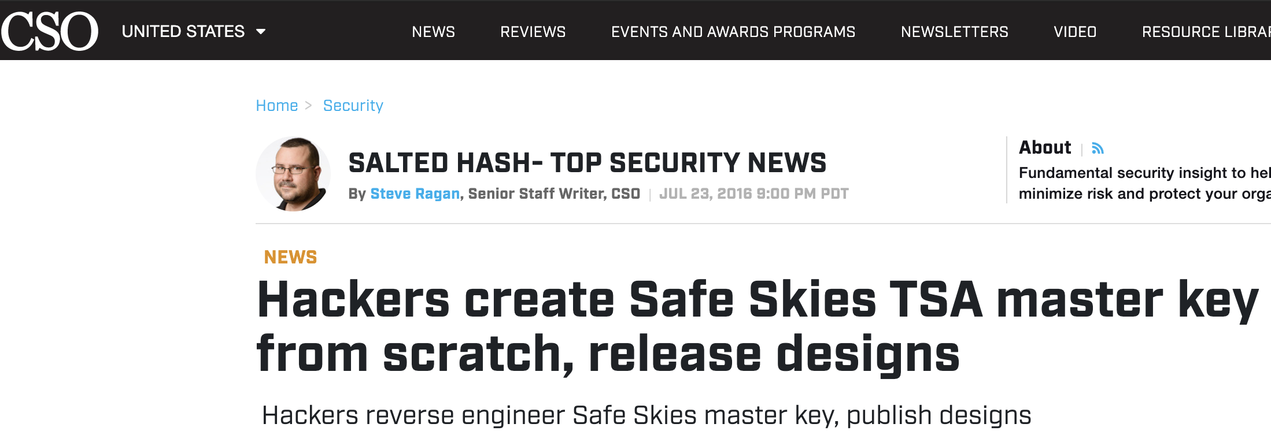
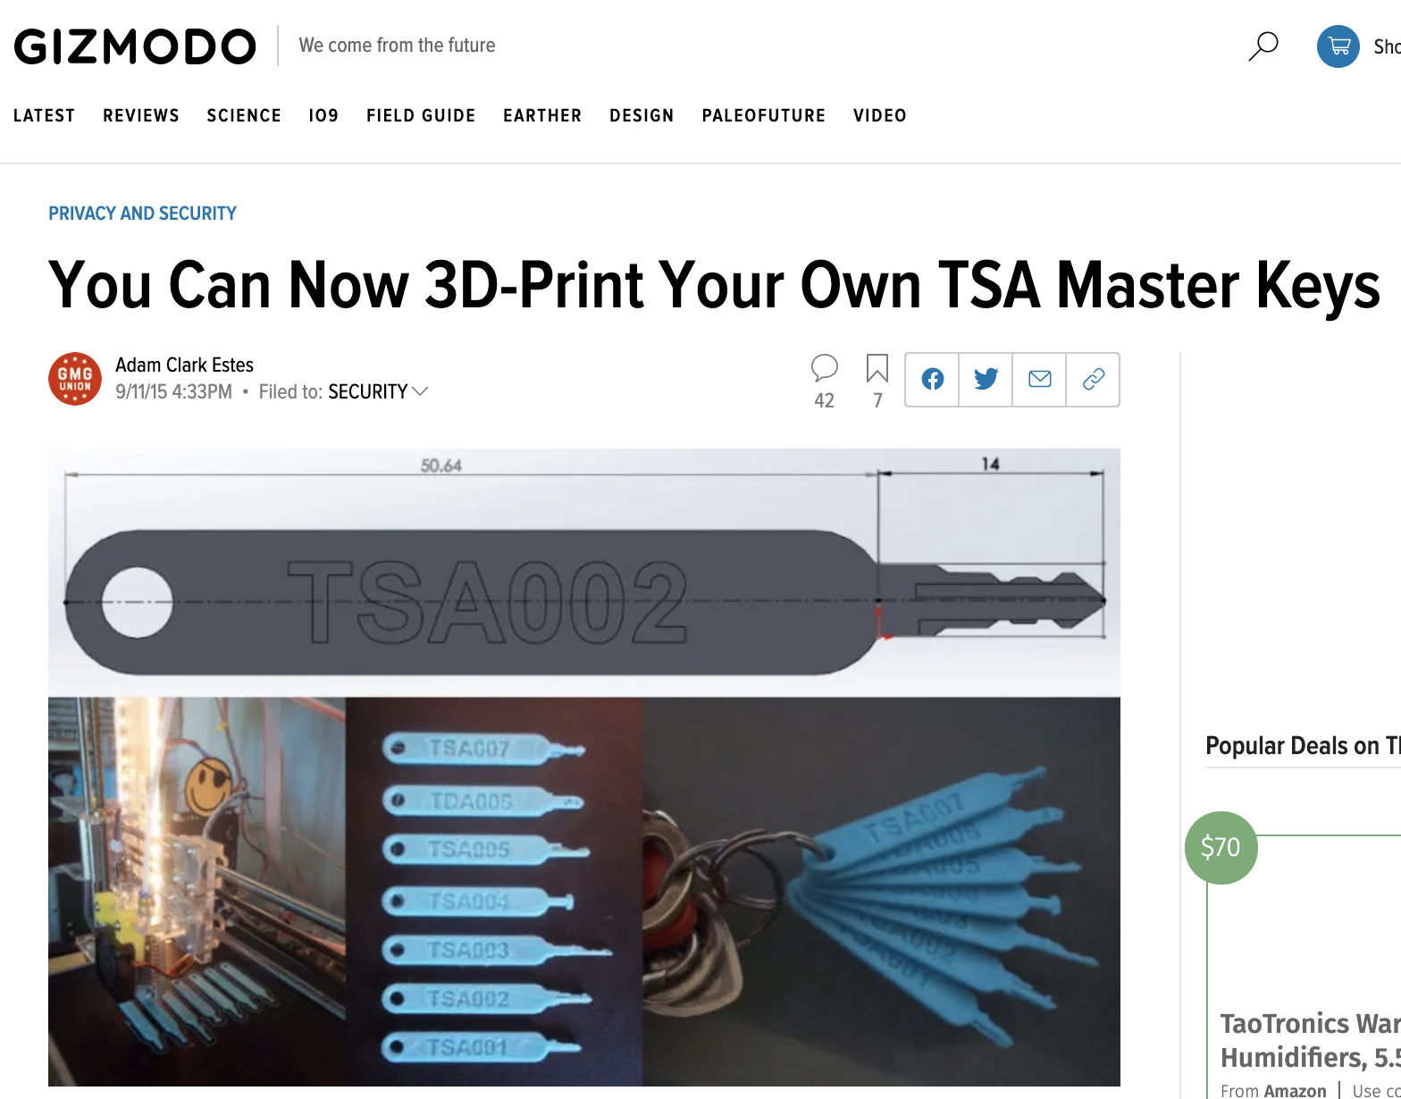
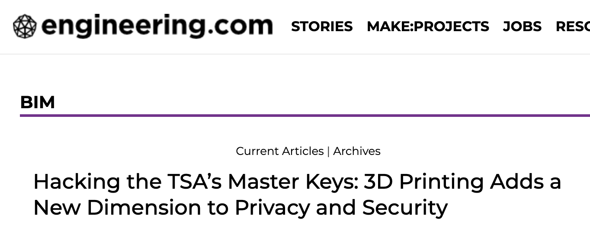
~ % whoamitho
Trainer, AppSec Analyst & Sr. Researcher (& “Whatever Else”) for GRIMM
More applicably, this guy:
Notes:
As such, gonna focus mainly on the 3D printing efforts (but will gloss over others)

Slide 3
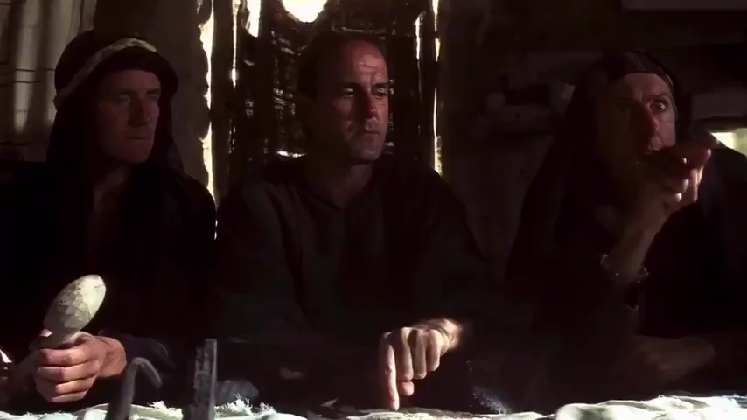
What’s Going on ?
The US did not have a proper plan in place for a Pandemic
Mass production of PPE (or most anything) is a balance and can’t shift rapidly
“Any port in a storm” leads to repurposing of rapid prototyping systems
Notes:
GiF covers the first point
Mass production is a balance of making sure you have enough materials inventory for the upcoming “season,” but also buying more if you think your materials might cost more in the future. Sure, you build in plans for increase demand, but not the 10x-10,000x (in the case of ventilators) that we’re seeing
Airlines do this with fuel which is why flight prices aren’t immediately affected by fuel prices.
This opened the door to a fallback onto Rapid Prototyping devices like 3D printers

Slide 4
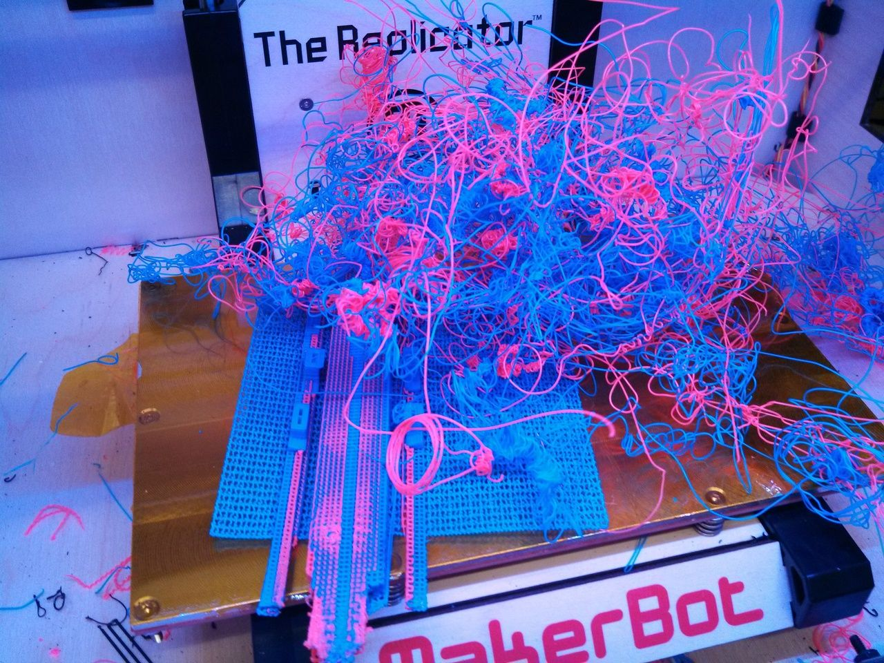
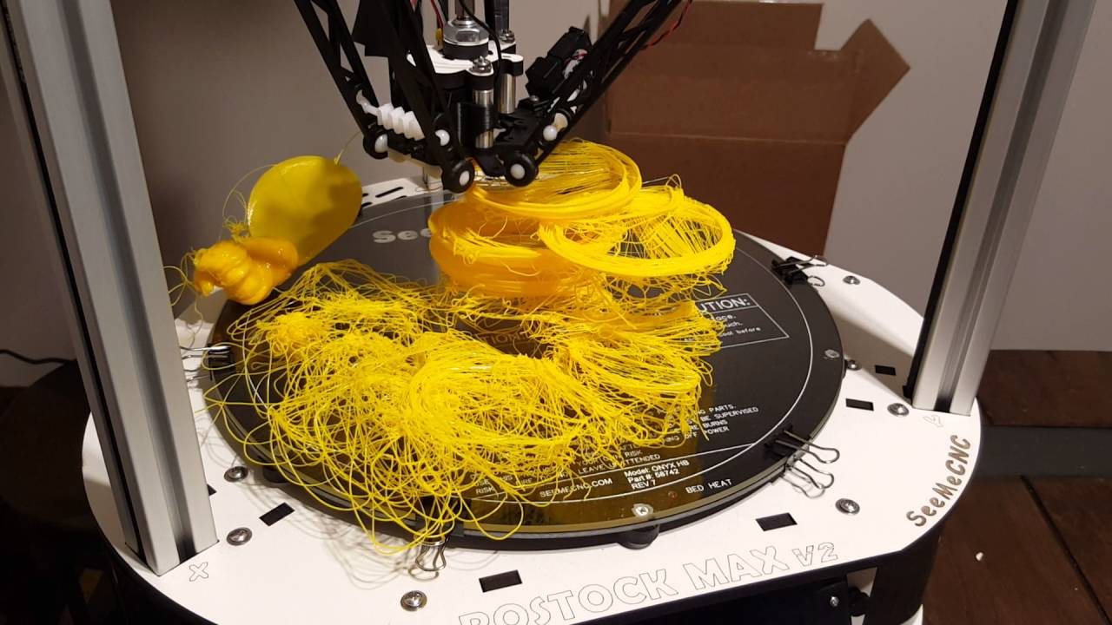
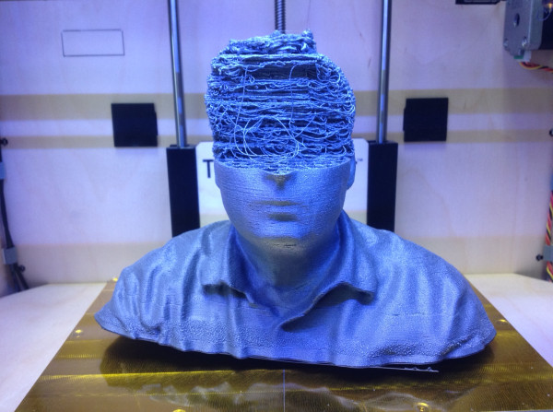
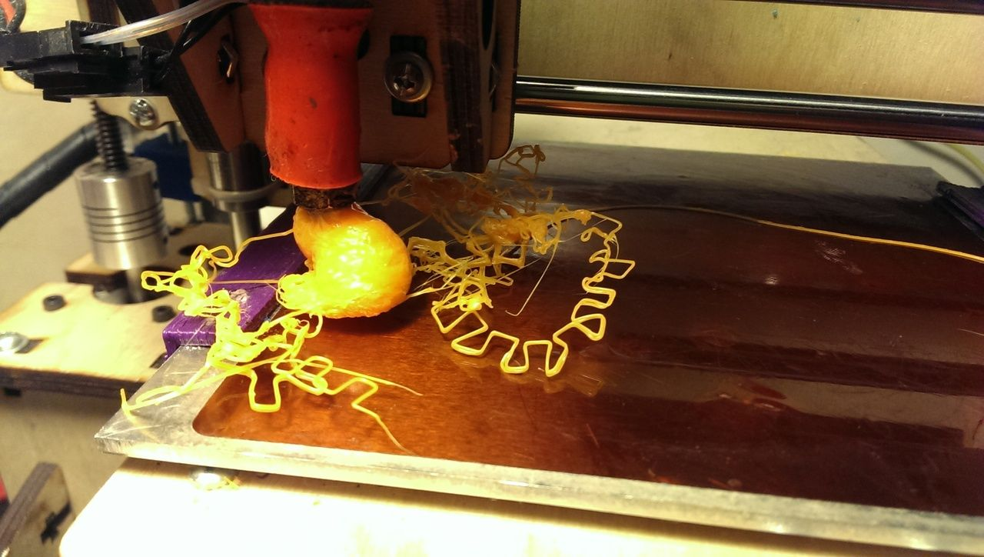
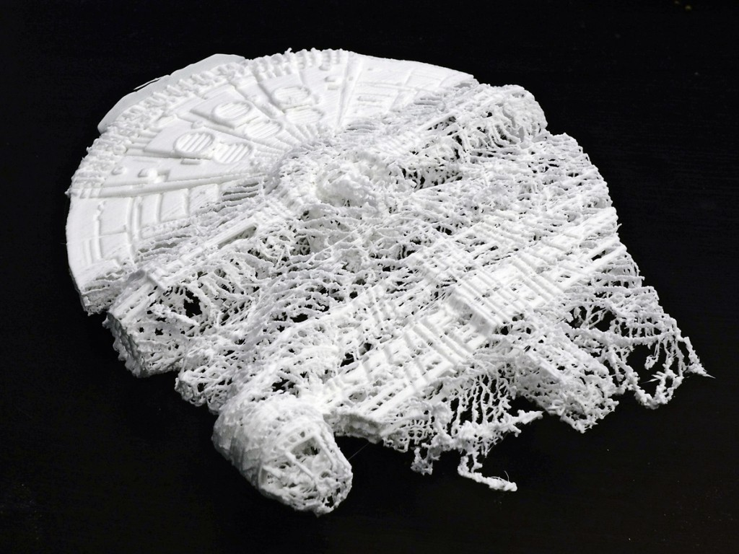
Isn’t 3D Printing Perfect, Futuristic Magic?
Notes:
Why is this a fallback? Why isn’t 3D printing the de facto manufacturing standard by now?
LOL NO (details next slide)

Slide 5
Isn’t 3D Printing Perfect, Futuristic Magic?
Affected by environmental factors
Difficult to make durable goods
EXTREMELY SLOW
Notes:
Liquid + gravity means not all designs can actually be built
40-70 min per face shield band

Slide 6
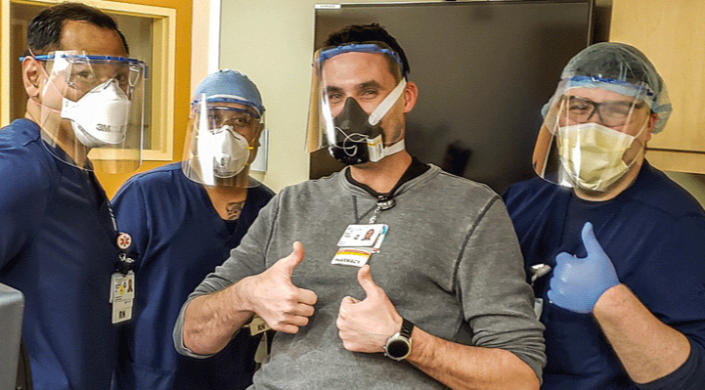
…and yet, WE’RE DOING IT!
Notes:
And we’re doing it with much more than just 3D printers (NEXT)

Slide 7
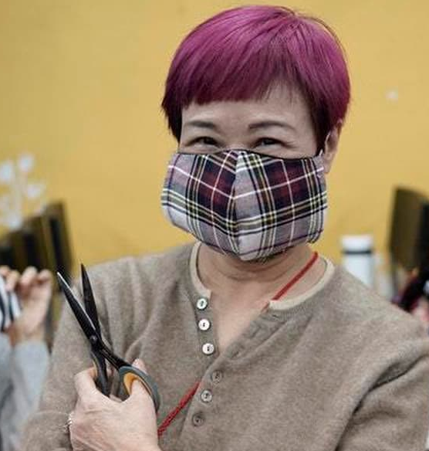
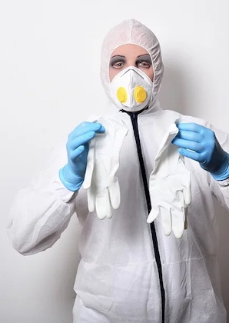
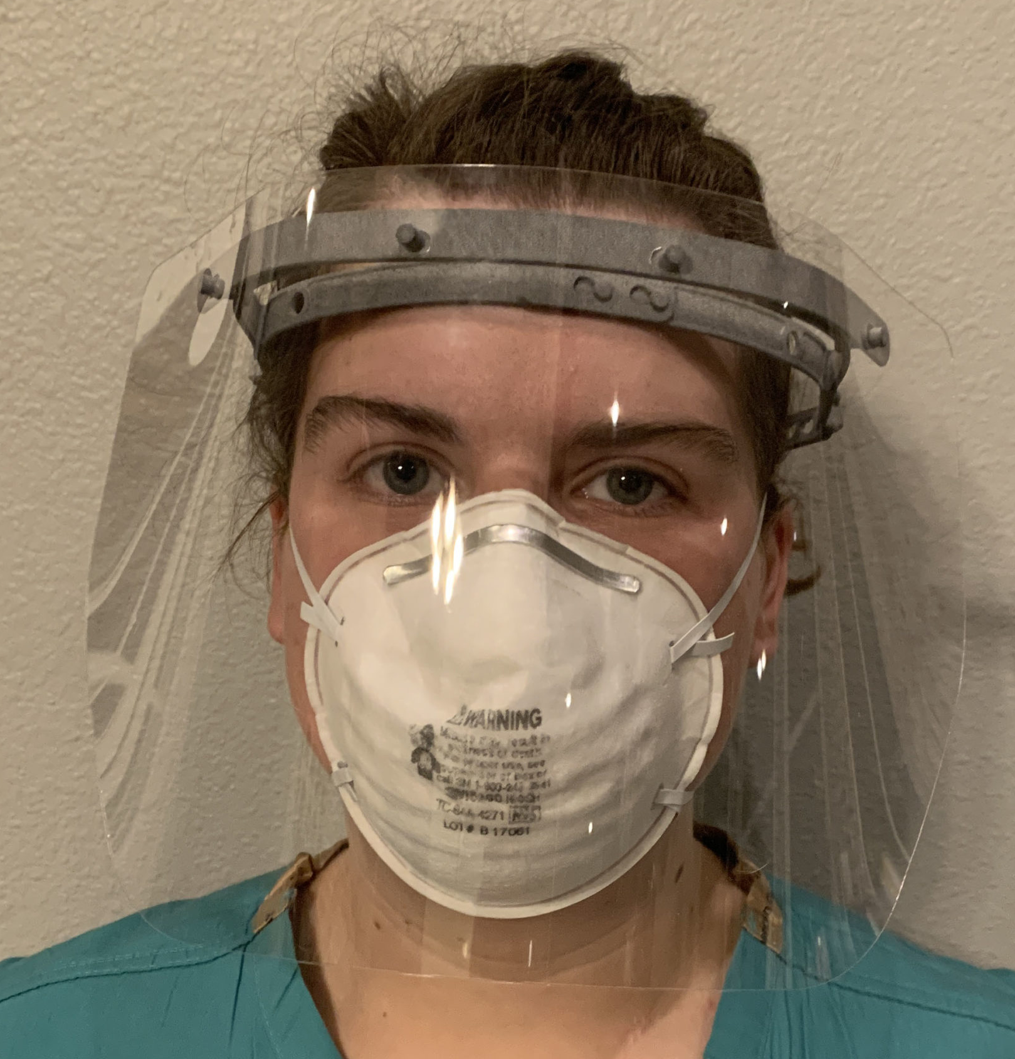
…and yet, WE’RE DOING IT!
Notes:
Pass to Patrick
(NEXT) But how do we get tens of thousands of people to collaborate?

Slide 8
Tower of Babel
Social Media = 140,000 groups, all vying to be The One
Slacks Slacks Slacks Slacks Slacks Slacks Slacks Slacks
Endless Unanswered Google Forms
Hoarding of materials
Production of PPE which shouldn’t be used
See the title of this talk
Notes:
Most popular Chicago Facebook group (serving national Swedish hospital network) run by elderly woman with very little knowledge of FB groups but also won’t ad admins
Most of the Chicago M4D group has been banned from her group for MENTIONING OTHER GROUPS. Oceans of infighting and false information. People speaking with authority on things they don’t understand, like what sterilization procedures hospitals use for various items, and what types of materials can withstand that.
Misunderstanding of terminologies and process, such as “clinical trials” vs “used in a clinic”

Slide 9
“From Chaos, Comes Order”
Prusa & 3DVerkistan issue strong designs that are fast to print.
NIH certifies designs for use, hosts 3D designs repo
Concise PDFs and “Infograms” achieve mass circulation
Non-nerds can help with low-tech makes
“Cloth” wearables are easy enough for beginners to make
- Nietzsche

Slide 10
Where are we Now?
Hackerspaces & Internet stars put huge # of printers to work
Retail outlets donate materials
Some manufacturers selling pro PPE at cost
Community continues to tweak 3D models and invent new wearables
Notes:
Linus Tech Tips, Micro Center, Staples
Ear savers

Slide 11
More Info / How can you Help?
#GetUsPPE and getusppe.org if you have or need PPE, or want to donate $
Masks For Docs Slack: https://tinyurl.com/masksfordoctors
Join applicable channels, READ THE PINNED POSTS
https://3dprint.nih.gov/discover/
https://www.makemasks2020.org/mask-making-guide
Get on the horn.
Ask around your community.
FB / Reddit groups / Neighbor apps
Hackerspaces
You may be the one who has to jumpstart things.

Slide 12
Shoot First, Ask Questions Later
The Maker Response to COVID-19
Johnny Xmas - GRIMMcon 2020 || Github: JohnnyXmas || Twitter: J0hnnyXm4s || Twitch: j0hnnyxm4s

